Slide 1

A Periodic Table Approach
A Simplified Version of Biblical Hebrew Verb Paradigms:
Melak Alemayehu Tsegaw
Adventist University of Africa

Slide 2

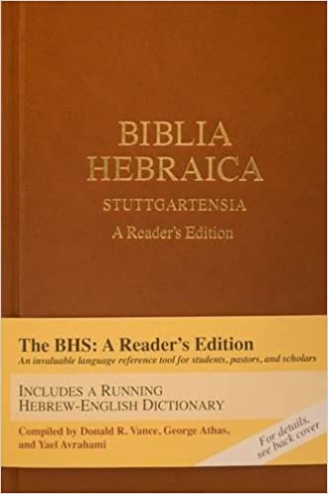
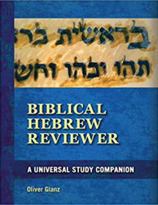
COMPREHENSIVE PRESENTATION
OF BH PARADIGMS
47
pages
22
pages
Biblia Hebraica Stuttgartensia:
A Reader’s Edition
Biblical Hebrew Reviewer:
A Universal Study Companion
Notes:
Can you pls make the first book to appear first and the second to follow when I click?

Slide 3
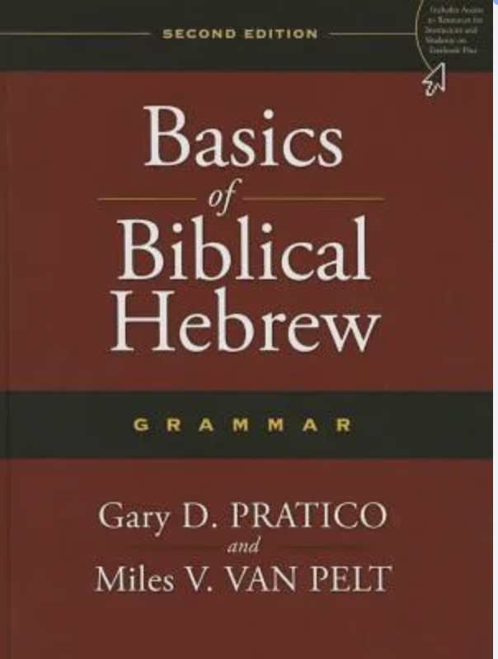

Slide 4

The Challenges of Using the Traditional Paradigms approach
Students feel overwhelmed and even discouraged at times.
Students will soon discover that there are significant number of weak verbs that they can not simply parse with the help of the strong verb paradigms on which they spend most of their time.
Notes:
If each one can disply when I click, it would be great.

Slide 5
The Challenges of Using the Traditional Paradigms approach
Students should first be able to know the root letters and the stem to consult the right table. And this poses a great challenge for beginners.
When one of the three consonants drops or assimilates, it will be more difficult to identify which paradigm to use.
Notes:
If each one can disply when I click, it would be great.

Slide 6
The Challenges of Using the Traditional Paradigms approach
Similar preformatives of different stems and conjugations require students to refer several tables.
Most of the tables do not show the changes that occur when a verb comes with objective suffixes.
The tables contain unattested forms that are of no use for the parsing of the BH text.
Notes:
If each one can disply when I click, it would be great.

Slide 7

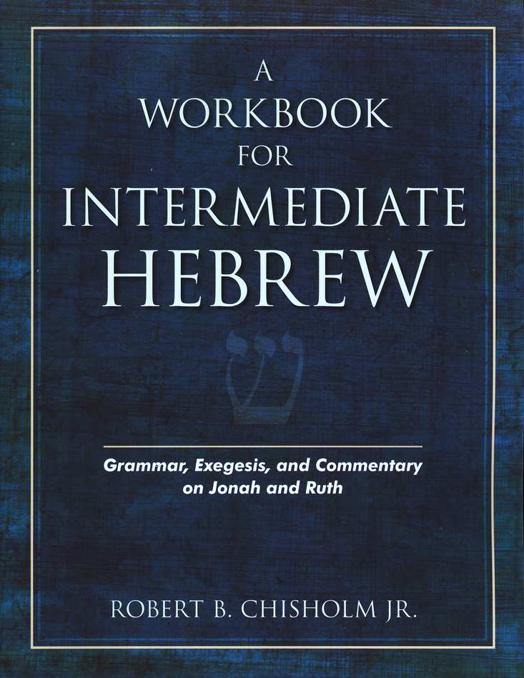
Another Approach(es)
Notes:
Let the slide with the title appear first and then the picture of the book can appear when I click.

Slide 8
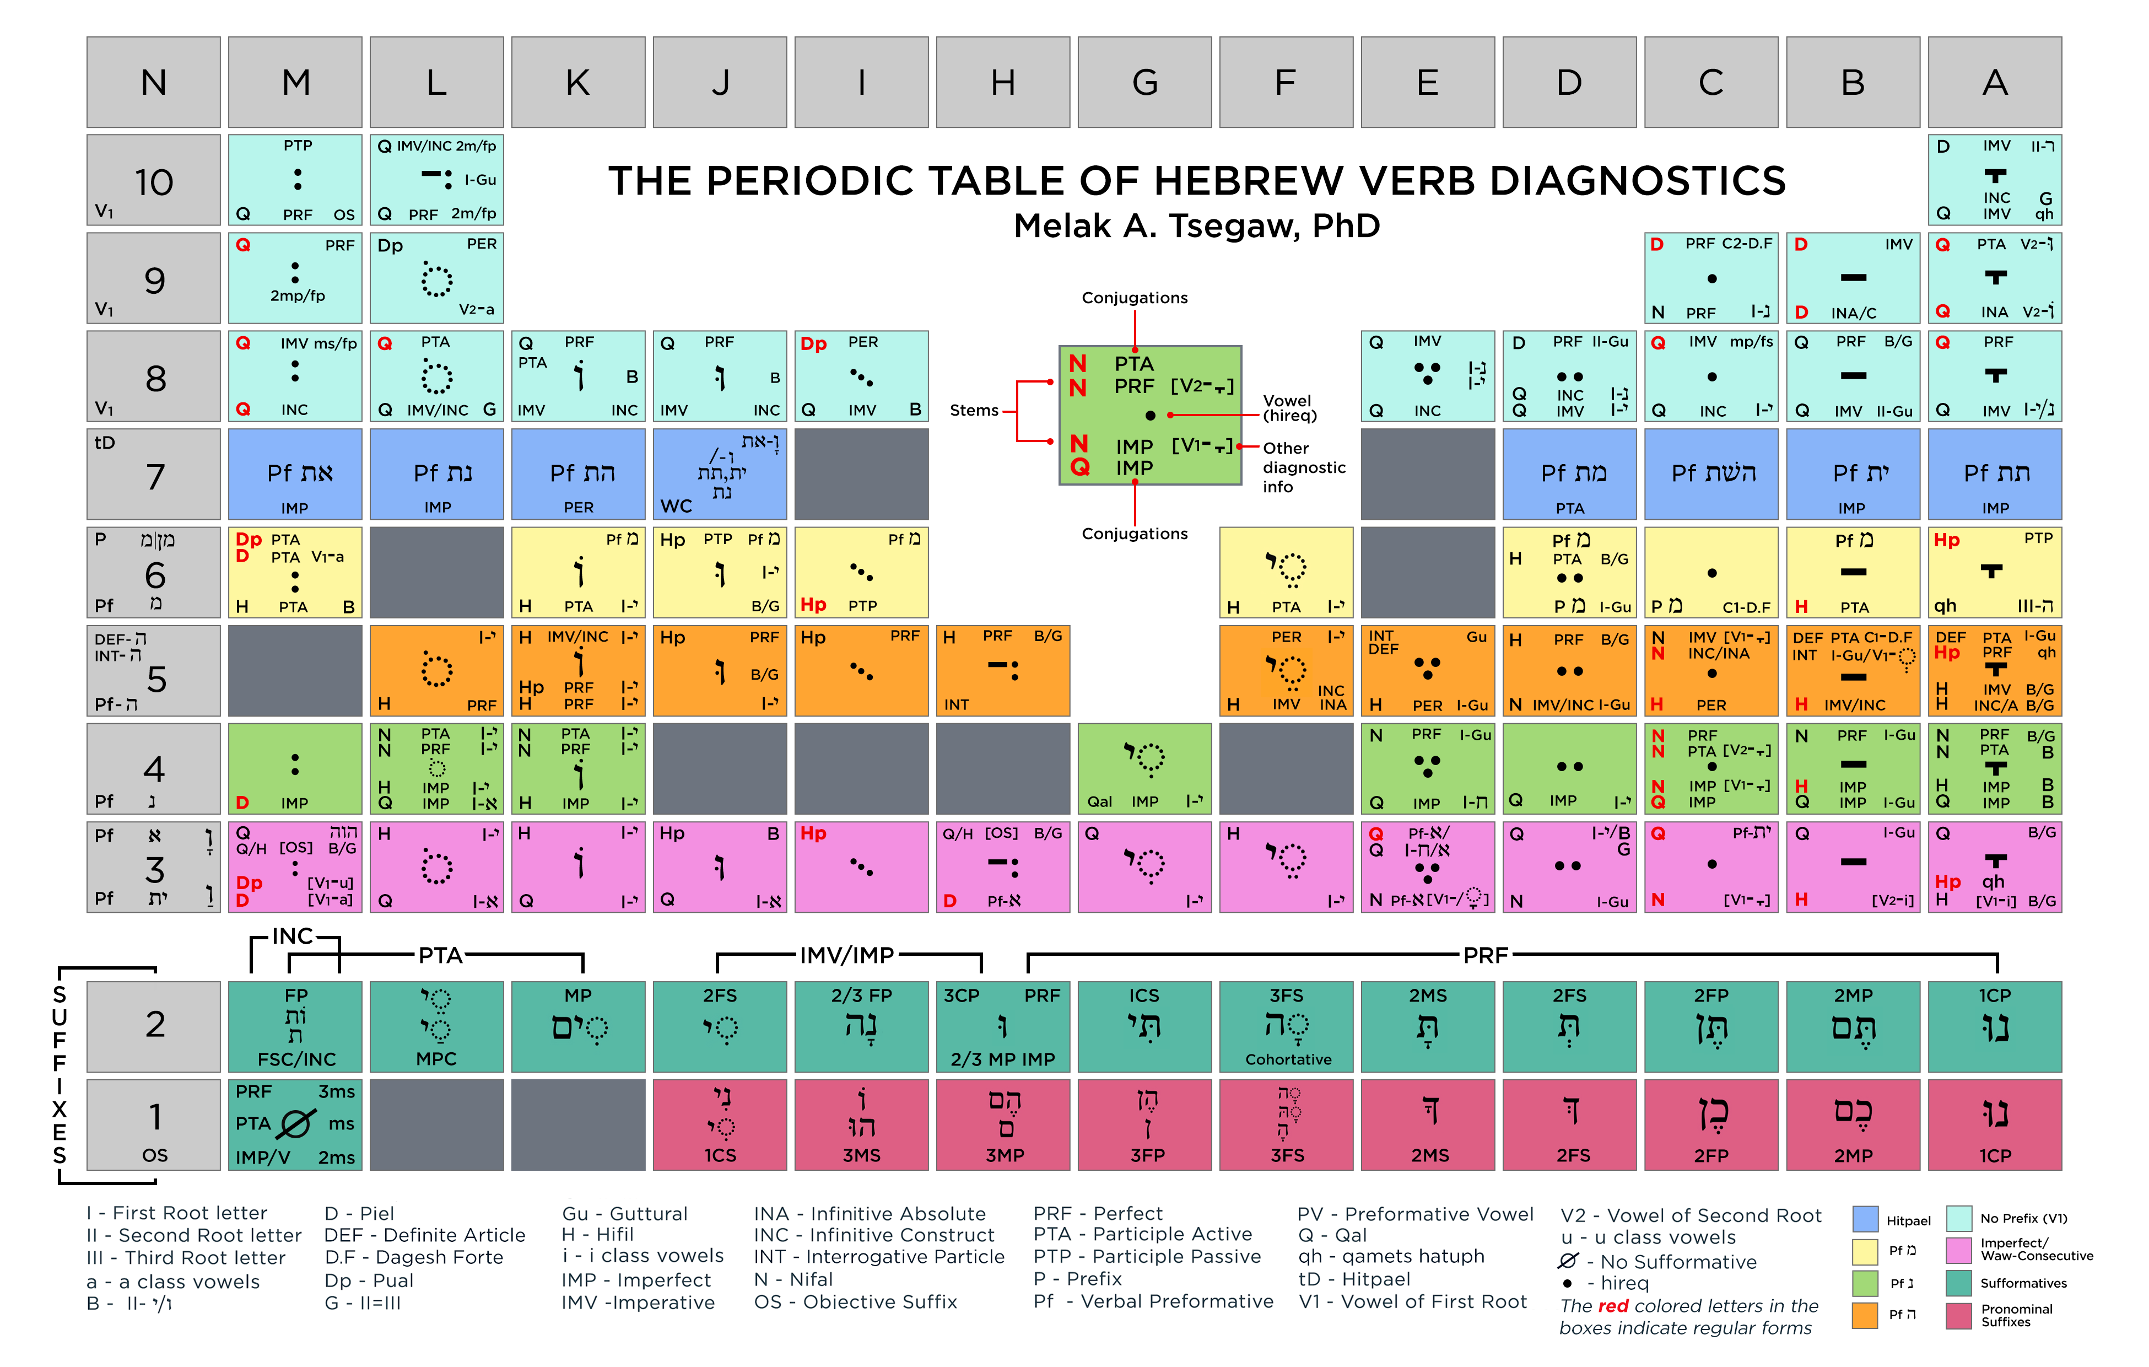
The Periodic Table Approach
47
pages

Slide 9

The Periodic Table Approach
Reference can be made to each box by combining its row and column.

Slide 10
Rows 1 and 2
Notes:
This is not the latest periodic table. (the latest one has 1L and 1K gray). Can you please adjust also the others?

Slide 11
Rows 3 to 6

Slide 12
Row 7

Slide 13
Rows 8 to 10

Slide 14

Recommended Steps
Step 1 - Check if suffixes of Row 1 and/or Row 2 are present
Step 2 - Check if the verb comes with a preformative and use the row that matches (Rows 3-7).
Step 3 - Check if the verb is without a preformative and focus on Rows 8-10.

Slide 15
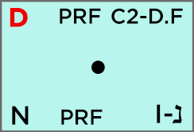
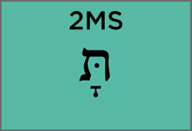
Examples
דִּבַּֽרְתָּ

Slide 16


Examples
ה֭וֹשַׁעְתָּנוּ

Slide 17
Pedagogical Advantages
of the Periodic Table Approach

Slide 18
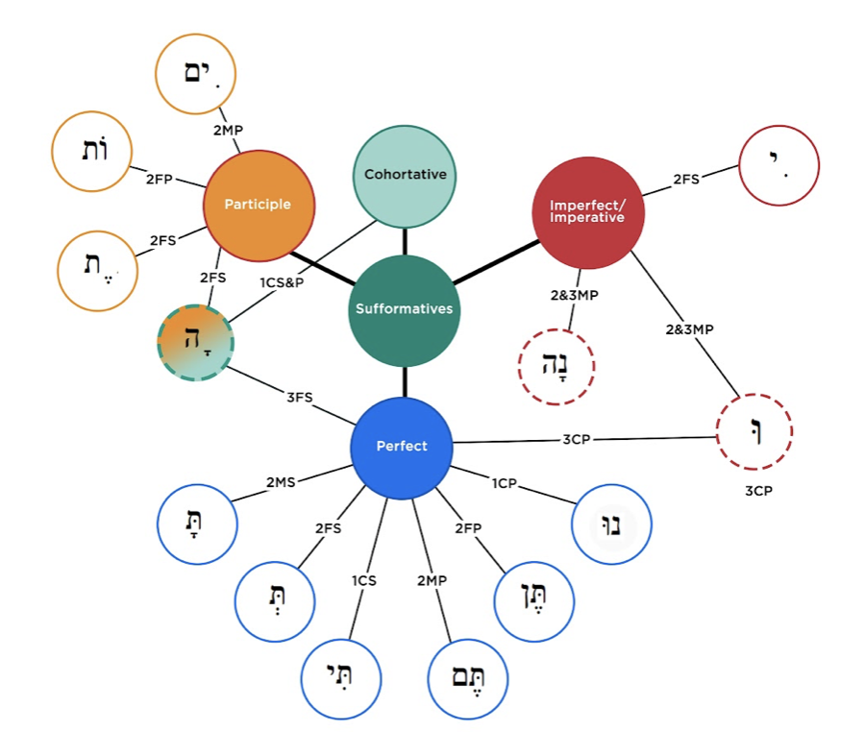
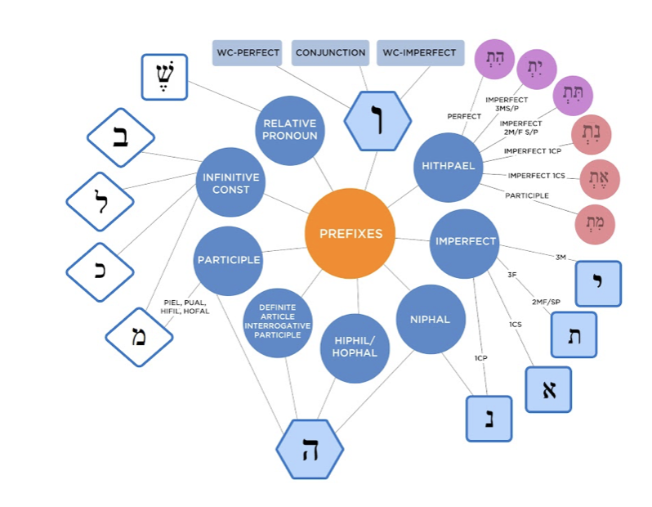
Pedagogical Advantages of the Periodic Table Approach
Recognition
Suffixes and Prefixes
Notes:
Please add the pictures I put

Slide 19

Pedagogical Advantages of the Periodic Table Approach
Recognition
Similar forms

Slide 20

Pedagogical Advantages of the Periodic Table Approach
Reconstruction
I-י
I-נ
II=י/ו
II=III
III-ה

Slide 21
Pedagogical Advantages of the Periodic Table Approach
Retention
The Periodic Table approach has helped students to grasp the morphological features of Hebrew verbs and aid their memorization of the diagnostics.

Slide 22

Student’s Testimonial
John Aubrey De Villiers
Obvious Bukhos Mpofu
Enock Sambongo

Slide 23

Conclusion
Work-in-Progress

